Slide 1
ggplot

Slide 2
Have you already installed Rstudio? If not, do it now!
First thing’s first….
https://www.rstudio.com/products/rstudio/download/#download

Slide 3
What is ggplot?
ggplot is a package (ggplot2) for ‘rapid exploration of data’ graphically in R
It is part of the ’tidyverse’
Notes:
ggplot2 excels at rapid visual exploration of data, but has some limitations in how it can be customized. Base graphics are fully customizable but can take longer to set up.

Slide 4






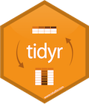

The tidyverse?
“An opinionated collection of R packages
that share an underlying philosophy”
Notes:
ggplot2 excels at rapid visual exploration of data, but has some limitations in how it can be customized. Base graphics are fully customizable but can take longer to set up.

Slide 5
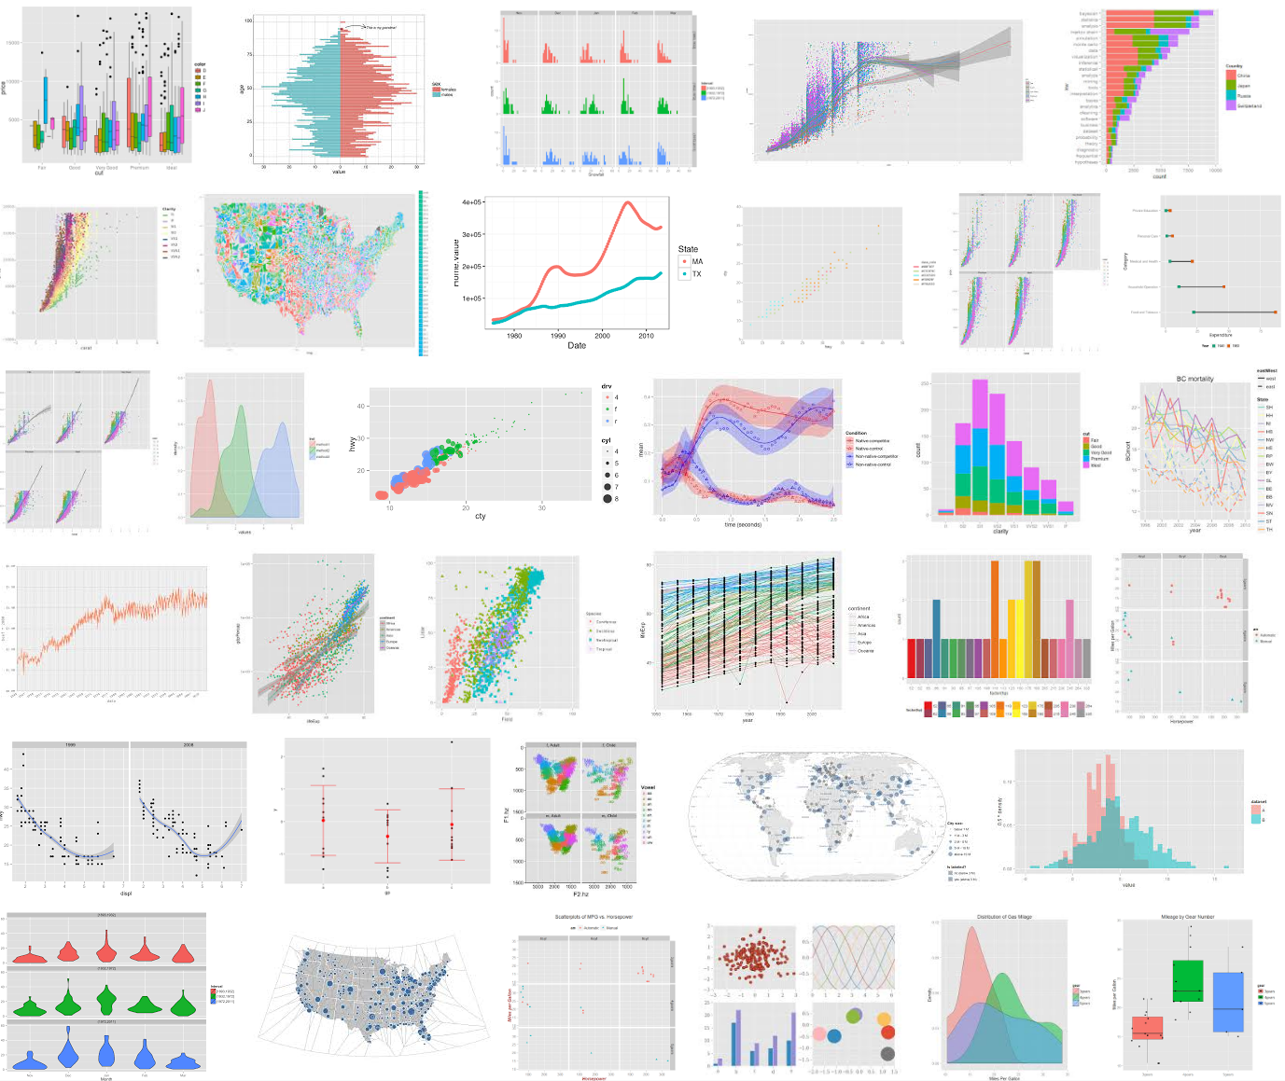
What is ggplot?
ggplot is a package (ggplot2) for graphing data in R

Slide 6
Some of our own ggplot2 graphics
Inspired yet?

Slide 7
Why “gg”?
gg is for “grammar of graphics”
Uses a set of terms that defines the basic components of a plot
Produces figures using coherent, consistent syntax

Slide 8
ggplot vs. base graphics
ggplot: rapid data exploration
Base graphics: customization / complexity
Saves time!
*From http://seananderson.ca/

Slide 9
ggplot uses specific grammar
A basic ggplot2 plot consists of:
data: Must be a data.frame
aesthetics: How your data are represented visually
x, y, color, size, shape, etc.
+
geometry: Geometries of plotted objects
points, lines, polygons, etc.
and more…

Slide 10
ggplot uses specific grammar
A basic ggplot2 plot consists of:
data: Must be a data.frame
aesthetics: How your data are represented visually
x, y, color, size, shape, etc.
+
geometry: Geometries of plotted objects
points, lines, polygons, etc.
and more…

Slide 11
ggplot uses specific grammar
A basic ggplot2 plot consists of:
data: Must be a data.frame
aesthetics: How your data are represented visually
x, y, color, size, shape, etc.
+
geometry: Geometries of plotted objects
points, lines, polygons, etc.
and more…

Slide 12
ggplot uses specific grammar
A basic ggplot2 plot consists of:
data: Must be a data.frame
aesthetics: How your data are represented visually
x, y, color, size, shape, etc.
+
geometry: Geometries of plotted objects
points, lines, polygons, etc.
and more…

Slide 13
ggplot uses specific grammar
A basic ggplot2 plot consists of:
data: Must be a data.frame
aesthetics: How your data are represented visually
x, y, color, size, shape, etc.
+
geometry: Geometries of plotted objects
points, lines, polygons, etc.
and more…

Slide 14
ggplot: Let’s get started!

Slide 15
Getting started: using packages
1
install.packages("ggplot2")
Downloads files to computer
1 x per computer

Slide 16
Getting started: using packages
1
2
install.packages("ggplot2")
library("ggplot2")
Downloads files to computer
1 x per computer
Loads package
1 x per R Session

Slide 17
Getting started: using packages
To install ggplot:
install.packages("ggplot2")
To load ggplot into workspace:
library("ggplot2")

Slide 18
ggplot grammar: data

Slide 19
head(iris)
ggplot grammar: data

Slide 20
str(iris)
ggplot grammar: data

Slide 21
x <- ggplot()
ggplot grammar: data
Then type:
x

Slide 22
x <- ggplot(data=iris)
ggplot grammar: data
Then type:
x

Slide 23
x <- ggplot(data=iris)
ggplot grammar: data
Then type:
x

Slide 24
ggplot grammar: aesthetics

Slide 25
x <- ggplot(data=iris, aes(x=Sepal.Length, y=Sepal.Width))
ggplot grammar: data
Then type:
x

Slide 26
x <- ggplot(data=iris, aes(x=Sepal.Length, y=Sepal.Width))
Getting started: quick code
Then type:
x

Slide 27
x + geom_point()
Reminder: x<- ggplot(data=iris, aes(x=Sepal.Length, y=Sepal.Width))

Slide 28
x + geom_point()
Reminder: x<- ggplot(data=iris, aes(x=Sepal.Length, y=Sepal.Width))

Slide 29
x <- ggplot(data=iris, aes(x=Sepal.Length, y=Sepal.Width, color=Species, shape=Species)) x + geom_point()

Slide 30
x <- ggplot(data=iris, aes(x=Sepal.Length, y=Sepal.Width, color=Species, shape=Species)) x + geom_point()
Change the visualization with aes()

Slide 31
x<-ggplot(iris,
aes(x=Sepal.Length, y=Sepal.Width,
color=Species))
x + geom_point() +
stat_smooth(method="lm")

Slide 32
x<-ggplot(iris,aes(x=Sepal.Length, y=Sepal.Width,
color=Species))
x + geom_point() +
stat_smooth(method="lm")

Slide 33
Woah!
What just happened?

Slide 34
Can layer on other features: e.g., stats
Inspired yet?
Woah!
What just happened?

Slide 35
ggplot grammar: data
Specify the data using data=
ggplot(data = _____, aes(___)) +
…use ‘+’ sign to add layers:
(1) geom (type of plotted data)
(2)… other stuff.. (stats, labels, facets, themes, etc)

Slide 36
ggplot grammar: geometry

